Slide 1
HOME CREDIT DEFAULT RISK
Team 5:
Louis Ackumey
Ian Donaldson
Michael Tom
Andrew Walton

Slide 2
COMPANY OVERVIEW
UNDERSERVED CUSTOMERS
OVER 25 YEARS IN BUSINESS
WORLDWIDE
REACH
RISK
MANAGEMENT

Slide 3
BUSINESS PROBLEM
LITTLE TO NO CREDIT HISTORY HARD TO PREDICT REPAYMENT

Slide 4
BUSINESS PROBLEM
LITTLE TO NO CREDIT HISTORY HARD TO PREDICT REPAYMENT
DEFAULTING ON LOANS COMPANY LOSES MONEY

Slide 5
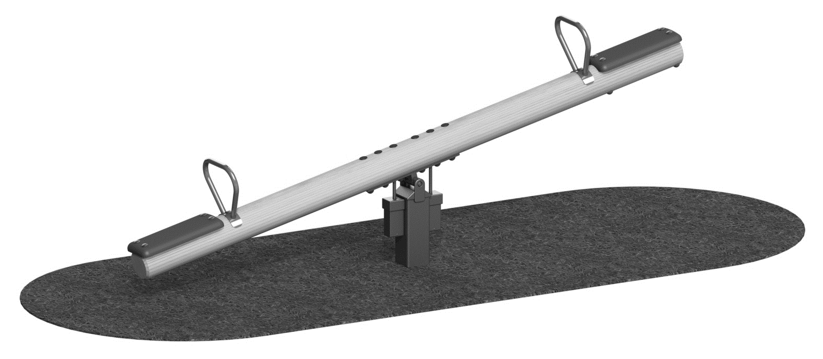
BUSINESS IMPACT
DEFAULT VS NON-DEFAULT

Slide 6
DATA EXPLORATION
CATEGORIZATION
MISSING DATA
TARGET IMBALANCE
DATA TRANSFORMATION
MODELING PREPARATION

Slide 7
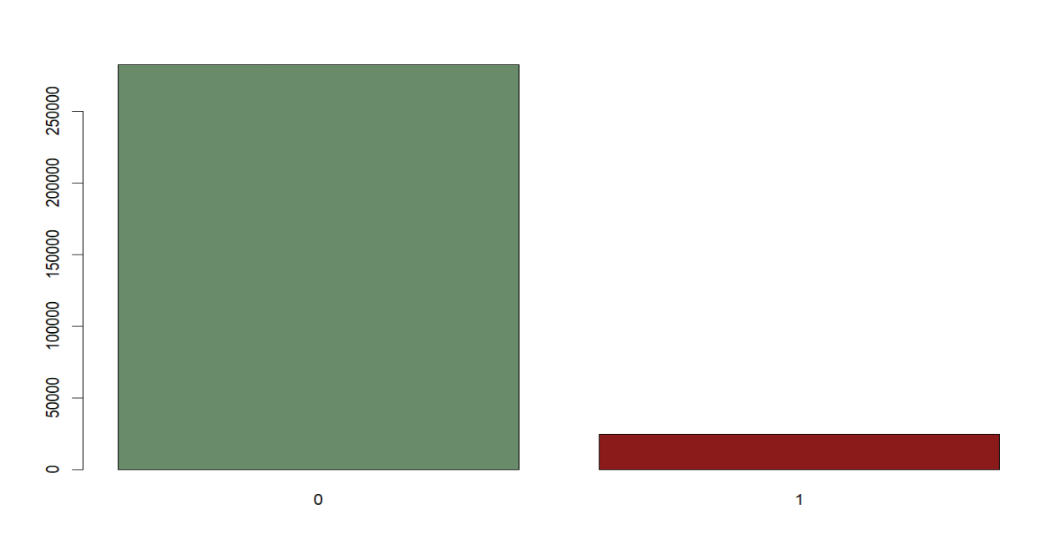
DATA IMBALANCE

Slide 8
DATA IMPUTATION
RETAINING FEATURES
NA THRESHOLD
& REMOVAL
FACTOR CONVERSION
ADDITIONAL TRANSFORMATIONS

Slide 9
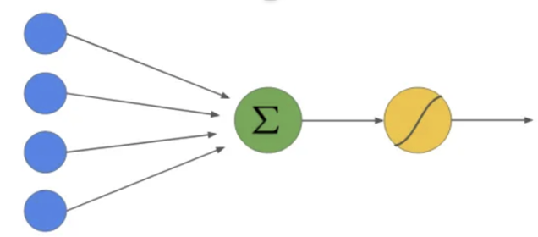
MODELS
LOGISTIC

Slide 10
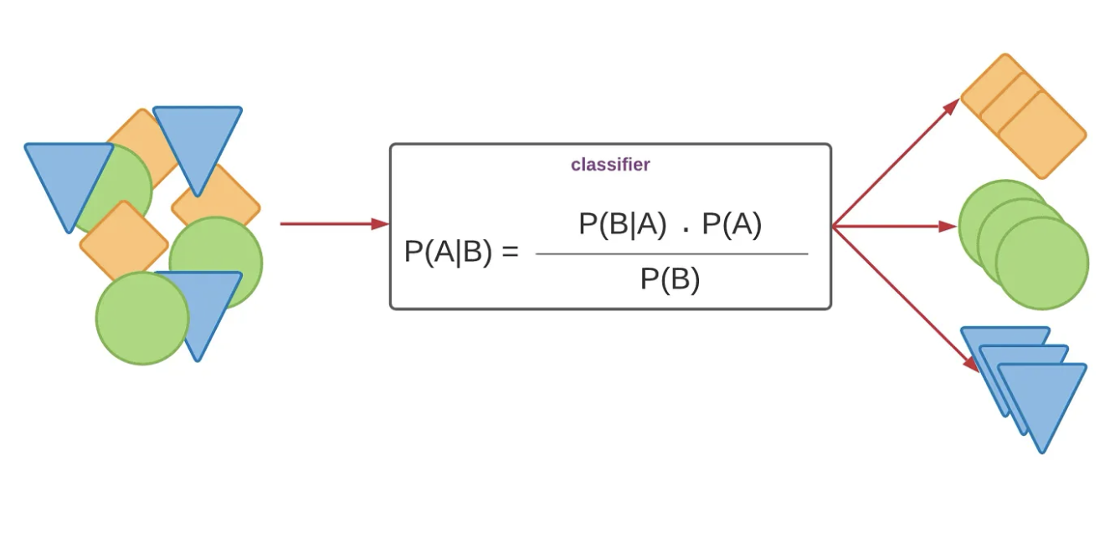
MODELS
LOGISTIC
NAÏVE BAYES

Slide 11
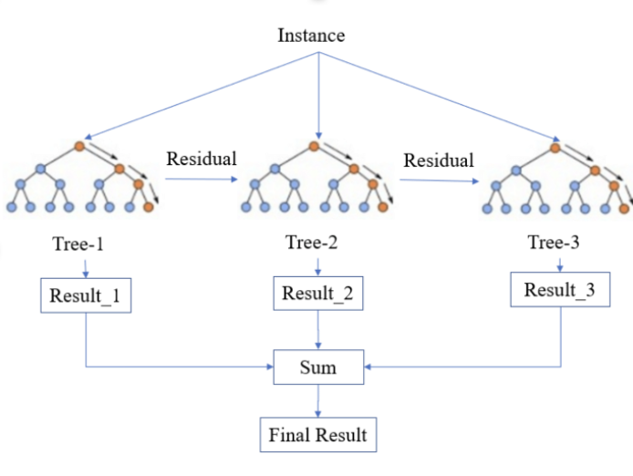
MODELS
LOGISTIC
NAÏVE BAYES
XGBOOST

Slide 12
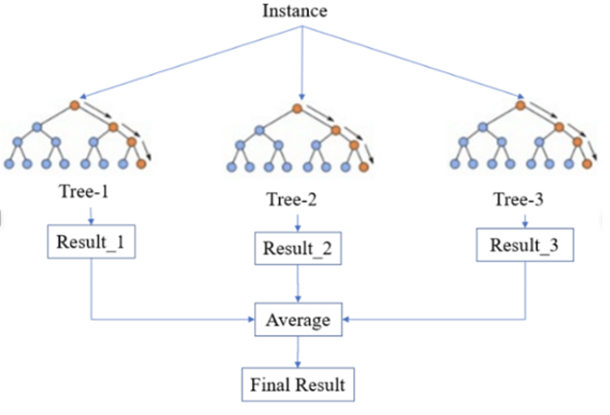
MODELS
LOGISTIC
NAÏVE BAYES
XGBOOST
RANDOM FOREST

Slide 13

RESULTS
MODEL | TEST AUC | KAGGLE AUC
Logistic with Upsampling | .732 | .724

Slide 14
RESULTS
MODEL | TEST AUC | KAGGLE AUC
Logistic with Upsampling | .732 | .724
Random Forest with Downsampling | .743 | .734

Slide 15
RESULTS
MODEL | TEST AUC | KAGGLE AUC
Logistic with Upsampling | .732 | .724
Random Forest with Downsampling | .743 | .734
XGBoost | .676 | .716

Slide 16
RESULTS
MODEL | TEST AUC | KAGGLE AUC
Logistic with Upsampling | .732 | .724
Random Forest with Downsampling | .743 | .734
XGBoost | .676 | .716
Naïve Bayes | .578 | NA

Slide 17

IMPORTANT PREDICTORS
EXT_SOURCE_1
EXT_SOURCE_2
EXT_SOURCE_3
CODE_GENDERM
FLAG_OWN_CARY
DAYS_EMPLOYED
DAYS_ID_PUBLISH
REGION_RATING_CLIENT_W_CITY
NAME_CONTRACT_TYPERevolving loans
FLAG_DOCUMENT_3
log_AMT_CREDIT

Slide 18
BUSINESS IMPACT
 | Actual
Prediction | Yes | No
Yes | 4,882 | 27,049
No | 2,565 | 57,755
Reduced Risk/Increased Revenue

Slide 19
APPLICATION EXAMPLE
Assumptions in $100k
Average Cost of Default Loan -$10
Average Revenue from Non-Default Loan $1
GROUP | MAJORITY CLASS CLASSIFIER |  | LOGISTIC MODEL
 | # Predicted | Cost/Rev | # Predicted | Cost/Rev
Non-Default Loan (TN) | 84,810 | $84,810K | 57,751 | $57,751K
Missed Non-Default Loan (FN) | 7,441 | -$74,410k | 2,565 | -$25,650K
Default Loan (TP) | 0 | $0 | 4,882 | $0
Missed Default Loan (FP) | 0 | $0 | 27.949 | $0
EST Total |  | $10,400K |  | $32,101K

Slide 20
APPLICATION EXAMPLE
Group | Majority Class Classifier |  | Logistic Model
EST Total |  | $10,400K |  | $32,101k
REVENUE
200%

Slide 21
APPENDIX

Slide 22
Data Preparation
Data Exploration:
Categorization of features into general topics:
Explored and categorized features into relevant variables. For example CODE_GENDER were identified and analyzed.
Handling variables with missing data:
Implemented strategies for variables with missing data, including imputation.
Example: Imputed missing values in DAYS_EMPLOYED, EXT_SOURCE_1 and ORGANIZATION_TYPE. Etc.
Balance of the Target Variable (Loan Default):
Investigated the balance of the target variable (loan default).
Ensured balance in the distribution of loan default cases.
Transformation necessity for model compatibility:
Explored the need for data transformations to enhance model compatibility.
By applying log transformations to variables like AMT_INCOME_TOTAL.
Modeling Preparation:
Addressed outliers and erroneous values to align the data for modeling.
Example: Conducting a comprehensive evaluation of variable correlations as a preliminary measure before modeling.

Slide 23
Data Preparation
Imbalance: Target variable
0/No | 1/Yes
282682 | 24825

Slide 24
Data Preparation
Data Imputation: Summary
Retaining Features:
Set NAs in ORGANIZATION_TYPE to "Undisclosed."
NA Threshold and Removal:
Set the NA threshold at 20%.
Remove columns exceeding the threshold.
Impute remaining NAs with the median. Example; EXT_SOURCE_1 etc.
Factor Conversion:
Convert the target variable to a factor.
Convert non-numeric columns to factors.
Additional Transformations:
Add log-transformed features (log_AMT_INCOME_TOTAL, log_AMT_CREDIT, log_AMT_ANNUITY).

Slide 25
Models
Logistic
Naive Bayes
Random Forest
XGBoost

Slide 26
Results
Model | Test AUC | Kaggle AUC
Logistic with Upsampling | .732 | .724
Random Forest with Downsampling | .743 | .734
XGBoost | .676 | .716
Naïve Bayes | .578 | NA

Slide 27
Important Predictors
EXT_SOURCE_1
EXT_SOURCE_2
EXT_SOURCE_3
CODE_GENDERM
FLAG_OWN_CARY
DAYS_EMPLOYED
DAYS_ID_PUBLISH
REGION_RATING_CLIENT_W_CITY
NAME_CONTRACT_TYPERevolving loans
FLAG_DOCUMENT_3
log_AMT_CREDIT

Slide 28
Business Impact
Logistic Model Confusion Matrix
 | Actual
Prediction | Yes | No
Yes | 36 | 59
No | 7,411 | 84,745
Potential to approve high amount of default loans

Slide 29
Application Example
Assumptions in $100k
Average Cost of Default Loan -$10
Average Revenue from Non-Default Loan $1
Group | Majority Class Classifier |  | Logistic Model
 | # Predicted | Cost/Rev | # Predicted | Cost/Rev
Non-Default Loan (TN) | 84,810 | $84,810K | 84,745 | $84,745K
Missed Non-Default Loan (FN) | 7,441 | -$74,410k | 7,411 | -$74,110K
Default Loan (TP) | 0 | $0 | 36 | $0
Missed Default Loan (FP) | 0 | $0 | 59 | $0
EST Total |  | $10,400K |  | $10,635K
2.25% Increase

Slide 30
Recommendation
Apply Logistic Model

